Slide 1

Airline Safety
Jennifer Ruiz
DSC 640
Professor Armstrong

Slide 2


A Look Ahead
- Central Message
- Review of Aviation Accidents
- Impact on Profits
- Next Steps

Slide 3

Central Message
Airlines are a safe, stable, and cost-effective means of travel.

Slide 4
Review of Accident Data

Slide 5

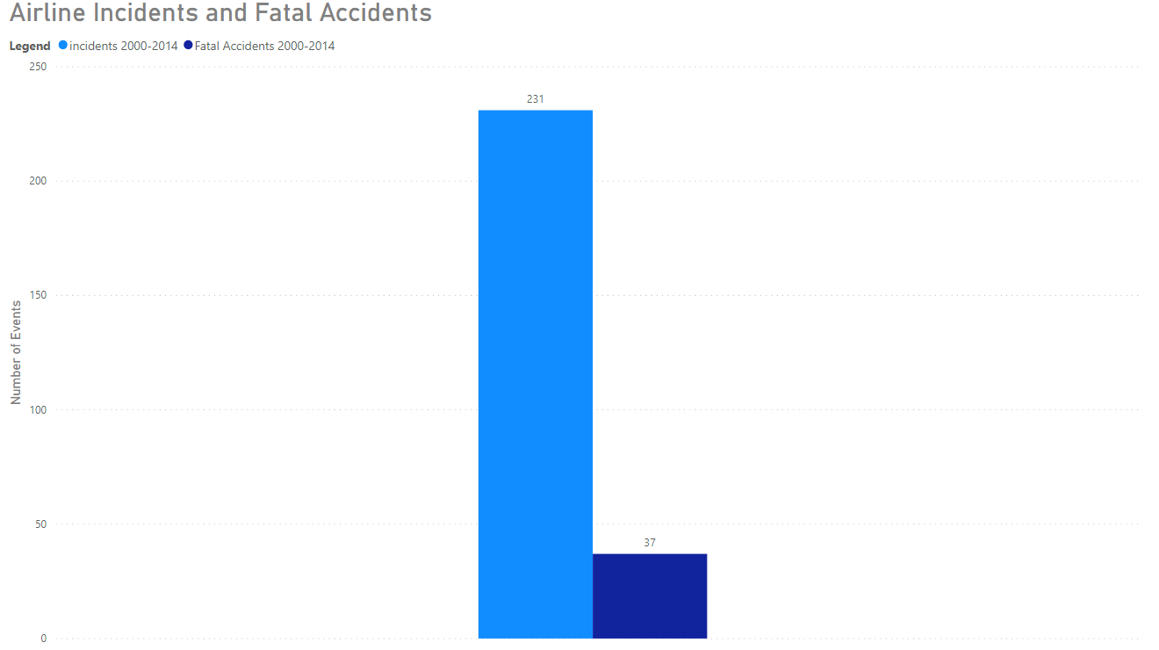

Slide 6
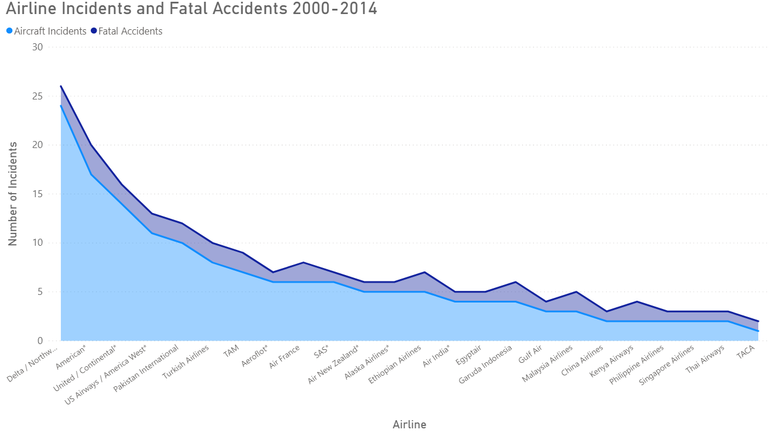

Slide 7
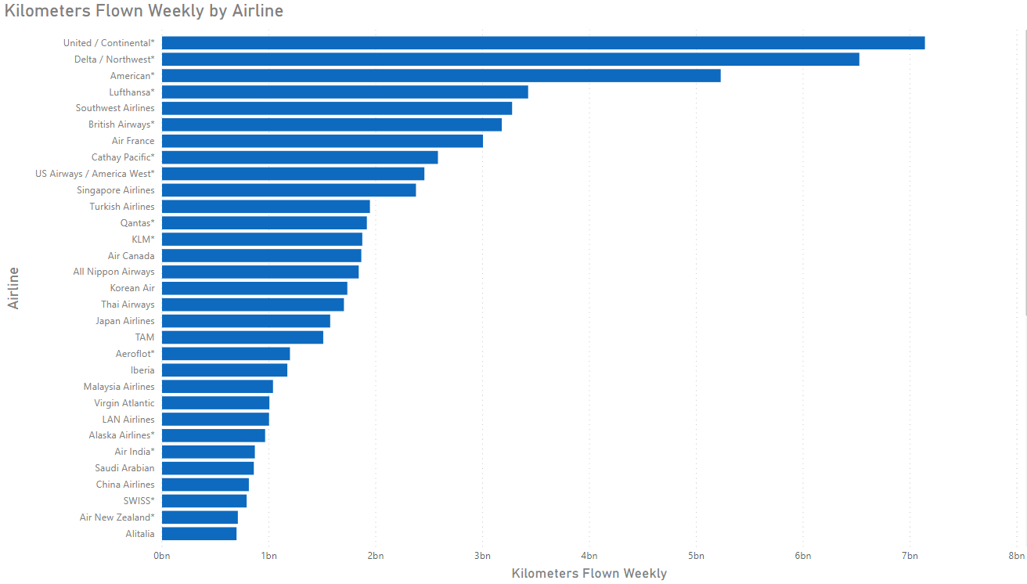

Slide 8
Impact on Profits

Slide 9
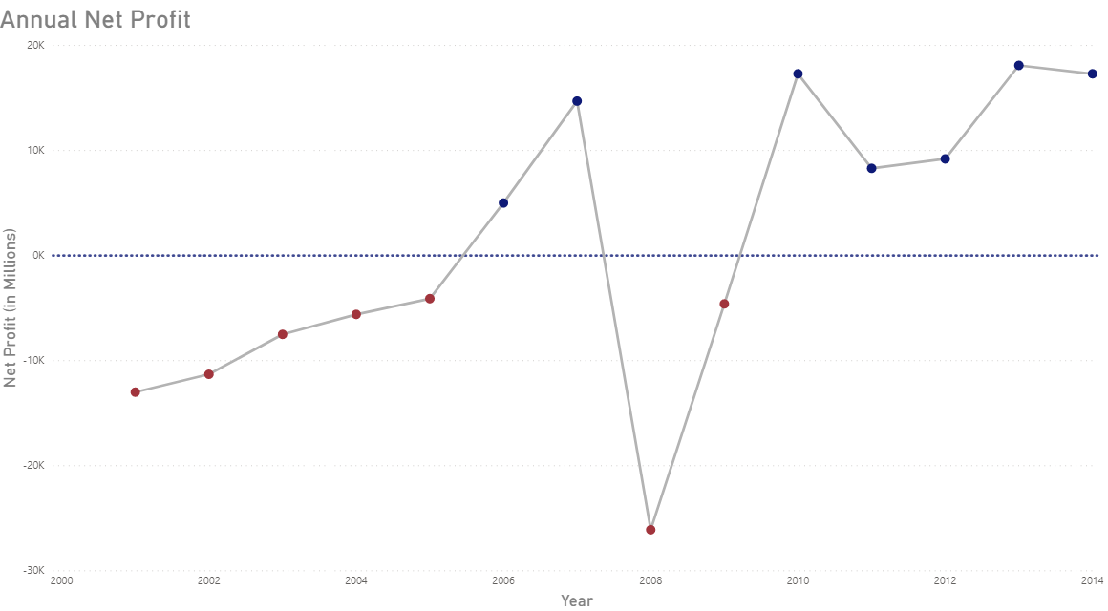

Slide 10
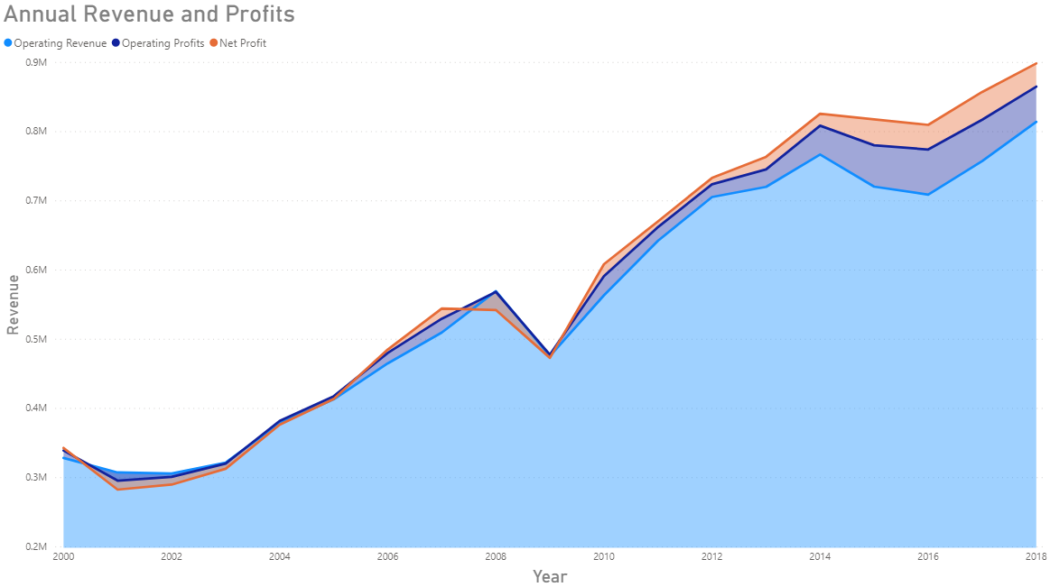

Slide 11
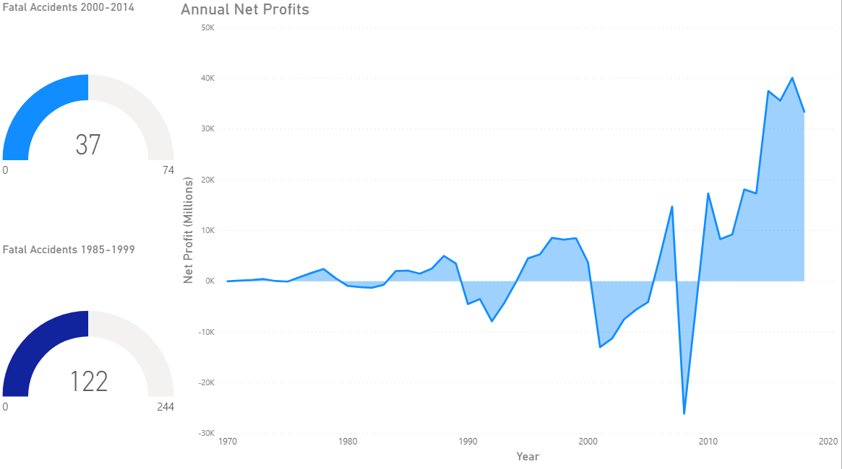

Slide 12
Key Takeaways for the Public
Since 2000, there have only been 37 fatal airline accidents.
Passengers fly more than 78 Billion kilometers weekly.
Airlines are a safe and reliable means of travel for consumers!

Slide 13
Stakeholder Takeaways
Revenue and Profits across the industry are effected by fatal accidents.
Contingency plans should be developed to protect financial state of individual airlines.

